Slide 1


Data
Analytics

Slide 2


Today’s Agenda
Project recap
Problem
The Analytics team
Process
Insights
Summary

Slide 3

asddfgvfm
Social Buzz is a rapidly expanding technology unicorn that must swiftly adapt to its global scale.
Accenture has initiated a 3-month Proof of Concept (POC) that centers around these specific tasks:
• A thorough examination of Social Buzz's big data practice.
• Recommendations for a successful IPO.
• Analysis to find Social Buzz's top 5 most popular content categories.
Project Recap

Slide 4


Problem
Over 100000 posts per day.
36,500,000 pieces of content per year!
But how to capitalize on it when there is so much?
Analysis to find Social Buzz's top 5 most popular categories of content

Slide 5



Andrew Fleming
Chief Technical
Architect
The Analytics team
Marcus Rompton
Senior Principle
Srishti Singh
Data Analyst

Slide 6
Process
1
Data Understanding
2
Data Cleaning
3
Data Modelling
4
Data Analysis
5
Uncover Insights

Slide 7

Insights
16
UNIQUE
CATEGORIES
1897
REACTIONS TO
“ANIMAL” POSTS
JANUARY
MONTH WITH
MOST POSTS

Slide 8
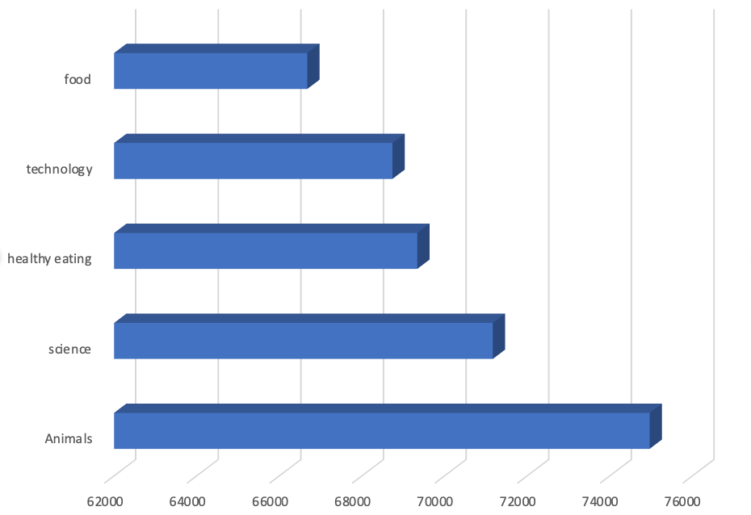
Top 5 categories with the largest aggregate popularity
category
Popularity Score

Slide 9
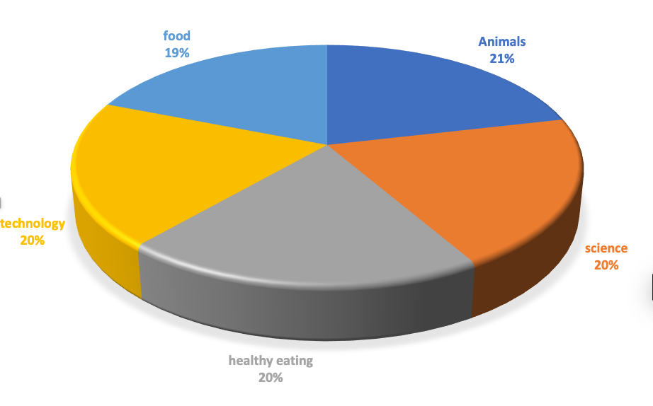
Percentage of popularity share from the top five categories

Slide 10

ANALYSIS
Animals and Science are highly sought-after categories of content, indicating a strong preference for "real-life" and factual information among people.
INSIGHT
Food is a popular topic, with the top 5 categories focusing on promoting a healthy lifestyle. This can provide insight to the audience within your user base. Utilize this valuable insight to develop a strategic campaign and collaborate with reputable healthy eating brands to enhance user engagement.
NEXT STEPS
This analysis provides valuable insights, and it is now crucial to transition from ad-hoc to large-scale production in order to gain real-time understanding of your business. We can demonstrate the process for you.
Summary

Slide 11

Thank you!
ANY QUESTIONS?

